Slide 1

Toward an Intelligent Agent for Fraud Detection – the CFE Agent
Joe Johnson <johnsj3@rpi.edu>

Slide 2
Goal
Create an agent that can successfully take a psychometric exam whose questions relate to the domain of fraud detection.

Slide 3
ACFE
Association of Certified Fraud Examiners
  www.acfe.com

Slide 4
CFE Exam
CFE Exam
  Required for certification in ACFE
  Based on information in the Fraud Examiners Manual (FEM)
  Taken by computer
  4 sections
    Financial Transactions and Fraud Schemes
    Law
    Investigation
    Fraud Prevention and Deterrence

Slide 5
CFE Exam
Each section
  consists of 125 multiple choice/True-False questions
  Must get 75% correct on each section to pass
  2.6 hours allowed to take each section
  Max of 75 seconds for each question

Slide 6
CFE Exam Prep Course Package
Contains the following:
  Fraud Examiners Manual (FEM)
  CFE Exam Prep Course Software
    gives practice questions (1500)
    3 practice exams
    CFE Exam

Slide 7
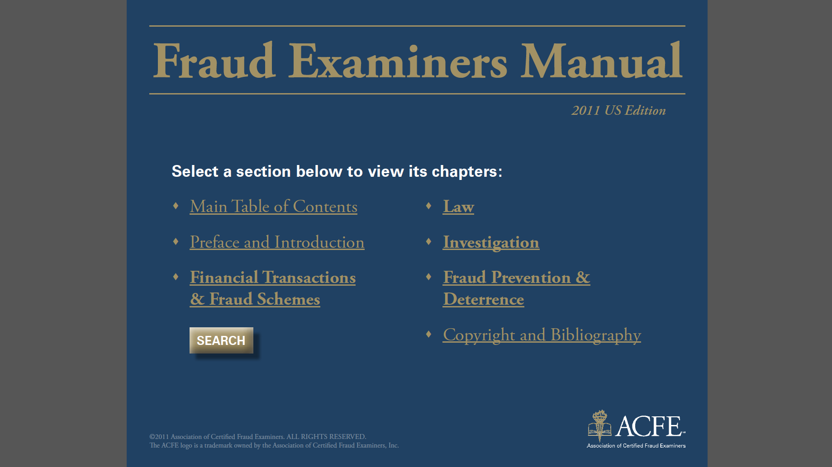
Fraud Examiners Manual

Slide 8
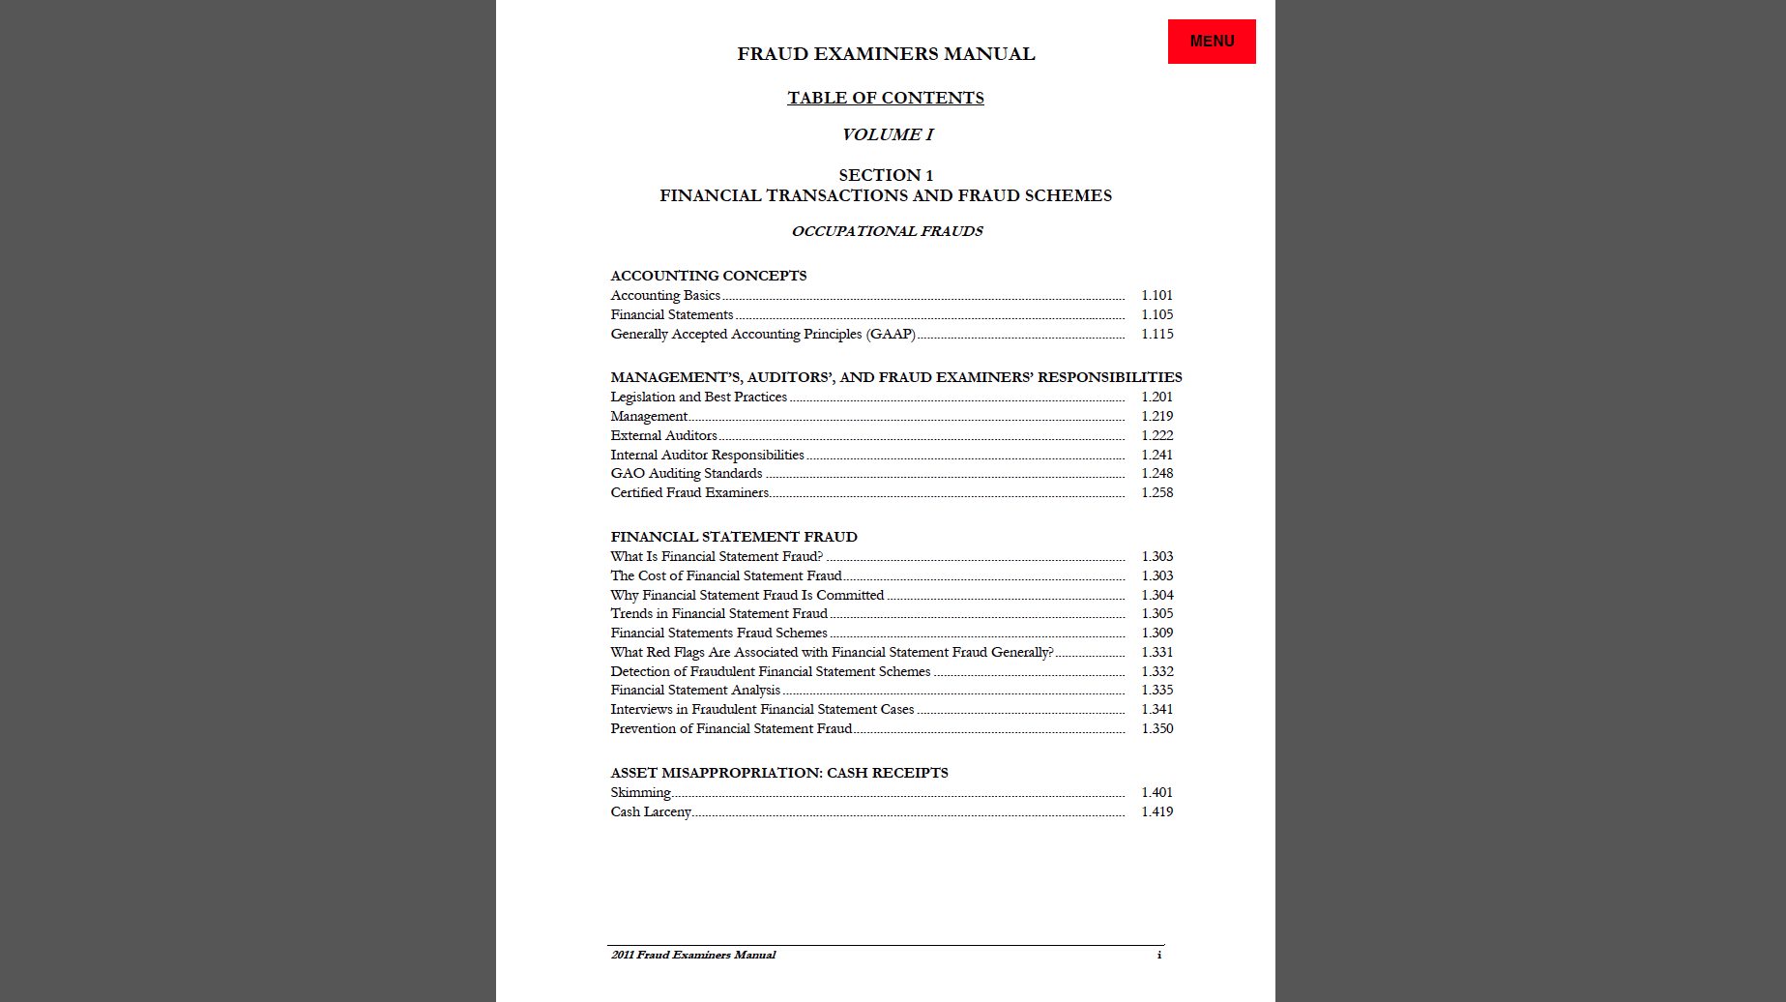
Fraud Examiners Manual - TOC

Slide 9
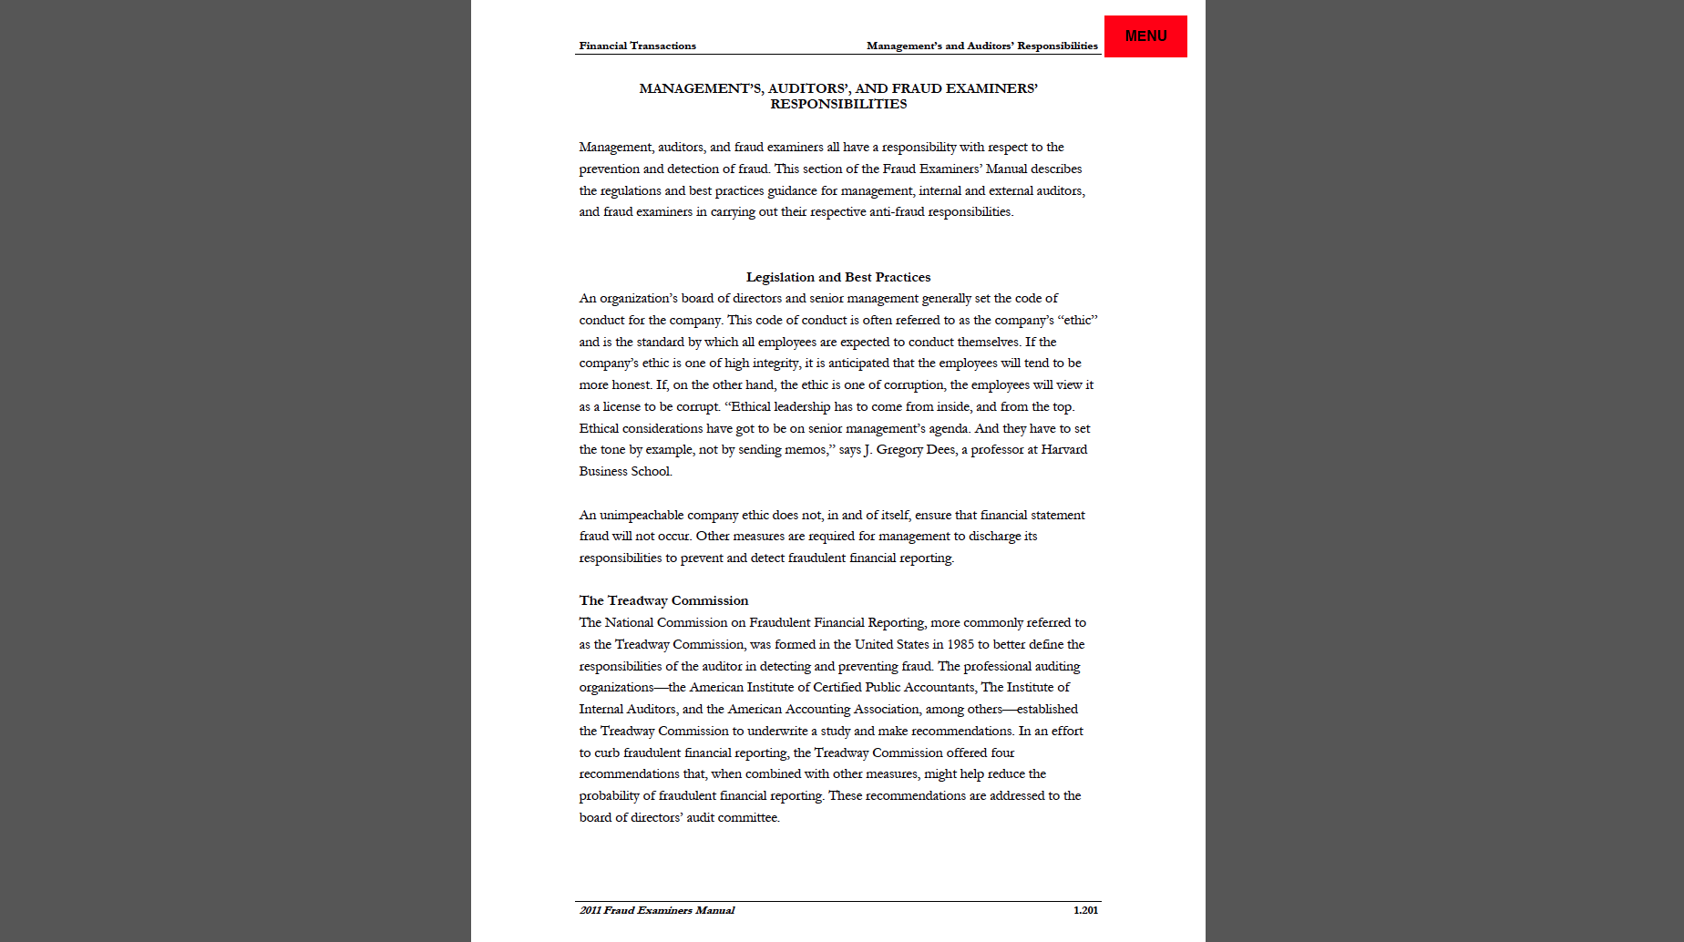
Fraud Examiners Manual - page

Slide 10
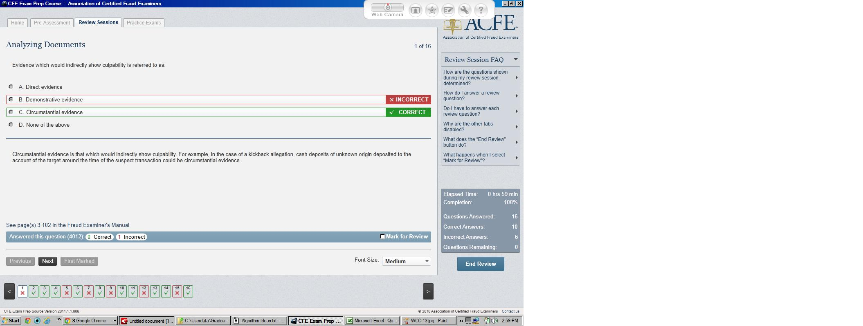
CFE Prep Course - Exam Questions

Slide 11
AI and test taking
Psychometric exams are common problems tackled in AI
Exams make use of many of the tools AI has to offer, making them a good playground
  Machine learning
  Natural language processing
  Computer vision
  Etc.

Slide 12
CFE Exam Agent
Inputs
  CFE Exam
  Fraud Examiners Manual (FEM)
Outputs
  Selected answer for each question
Goal
  Achieve 75% answer rate
Constraints
  75 seconds per question
  2.6 hours per section

Slide 13
Input – Exam Questions
Questions
  presented within CFE Exam software.
  Must be extracted from software so that they can be readily processed by the cfe exam agent.

Slide 14
Input – Exam Questions (contd.)
Question Conversion Procedure
  For each question
    Present in CFE Exam Prep Course Software (and answer it)
    Screen print the image and save to .jpg file.
    Convert .jpg image to text file using ocr software.
    Scrub text file (manual/automation)

Slide 15
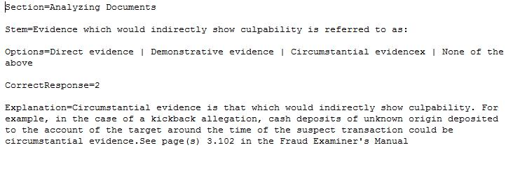
Question Conversion

Slide 16
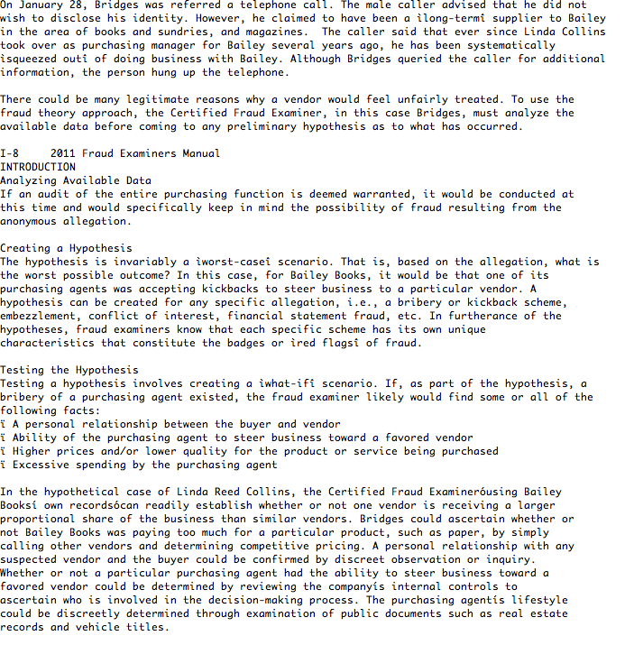
Input - FEM

Slide 17
Input – FEM (contd.)
Goal
  Automate the process as much as possible

Slide 18
Input – FEM (contd.)
Scrubbing issues
  Formatting
    Segregation of TOC sections from body text
  Page headers/TOC parsing
    Finite State Transducer
  Word segmentation

Slide 19
Input – FEM (contd.)
Word segmentation problem
  Example: “thetabledownthere”
    (Dale, Moisl, Somers: Handbook of Natural Language Processing. 2000)
  Could be:
    “the table down there”
    “theta bled own there”
  This is a well-known NLP problem where for English, at least, it’s largely unsolved
    English words have a unique distinction of having widely varying word length

Slide 20
Input – FEM (contd.)
Word segmentation problem
  Is a search problem
  Computational complexity explodes
  Heuristics attempted:
    BFS for each line of text
      first valid sequence is winner
    Exhaustive search for each line of text
      scores assigned to each based on the square of the length of the words
    Forward concatenation per line (greedy)
      Take out spaces until valid word moving in forward direction
  Critical choice is size of dictionary to match words against

Slide 21
CFE Exam Agent - Ouptut
Takes exam
  Processes each question one by one.
  Uses one of a number of algorithms to solve each question, based on question profile.

Slide 22
Exam Question Features/Ontology
True/False
True/False Absolute
  always, never, etc.
All of the above option
Except
  Question stem includes: “…all of the following….. except”
None of the Above option
Long Options
  Excluding all/none above, at least one other option has at least 4 words.
Definition
  All options have less than 4 words, excluding all/none above options

Slide 23
CFE Exam Agent Algorithms
Max Frequency
  Count up frequency of key phrase of each option within section of manual
Max Frequency Plus
  Frequency, also taking into account none/all above options
Min Frequency
  Intended for “except” questions
Composite Frequency
  Uses bag of words or max frequency based on whether question has long options

Slide 24
CFE Exam Agent Algorithms (contd.)
Bag of Words
  Composite of frequencies of the words in the option phrase
All of the Above
  pick that one!
True-False
  pick true!
False select
  Pick false (used for must, always, never questions).
Random
  If all else fails…

Slide 25
Question Features
All Of The Above (2^6)
None Of The Above (2^5)
Except (2^4)
True/False (2^3)
True/False Absolute (2^2)
Definition (2^1)
Has Long Option(s) (2^0)

Slide 26
Algorithm Selection Algorithm
For each question
  determine profile.
  Retrieve answer rates for all algorithm on questions with that profile.
  Pick the algorithm whose answer rate is highest for that profile

Slide 27
Results
True False – 58% accuracy on 463 questions
Multiple choice – 49% accuracy on 898 questions
Both are statistically significant at 99% confidence level
Overall performance not at level of passing.

Slide 28
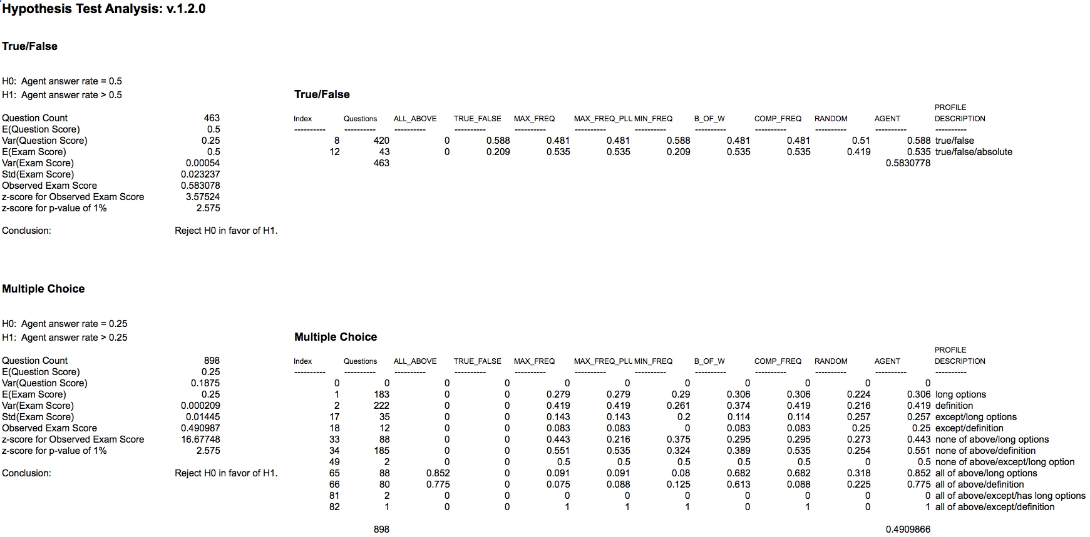
Performance Analysis – v.1.2.0

Slide 29
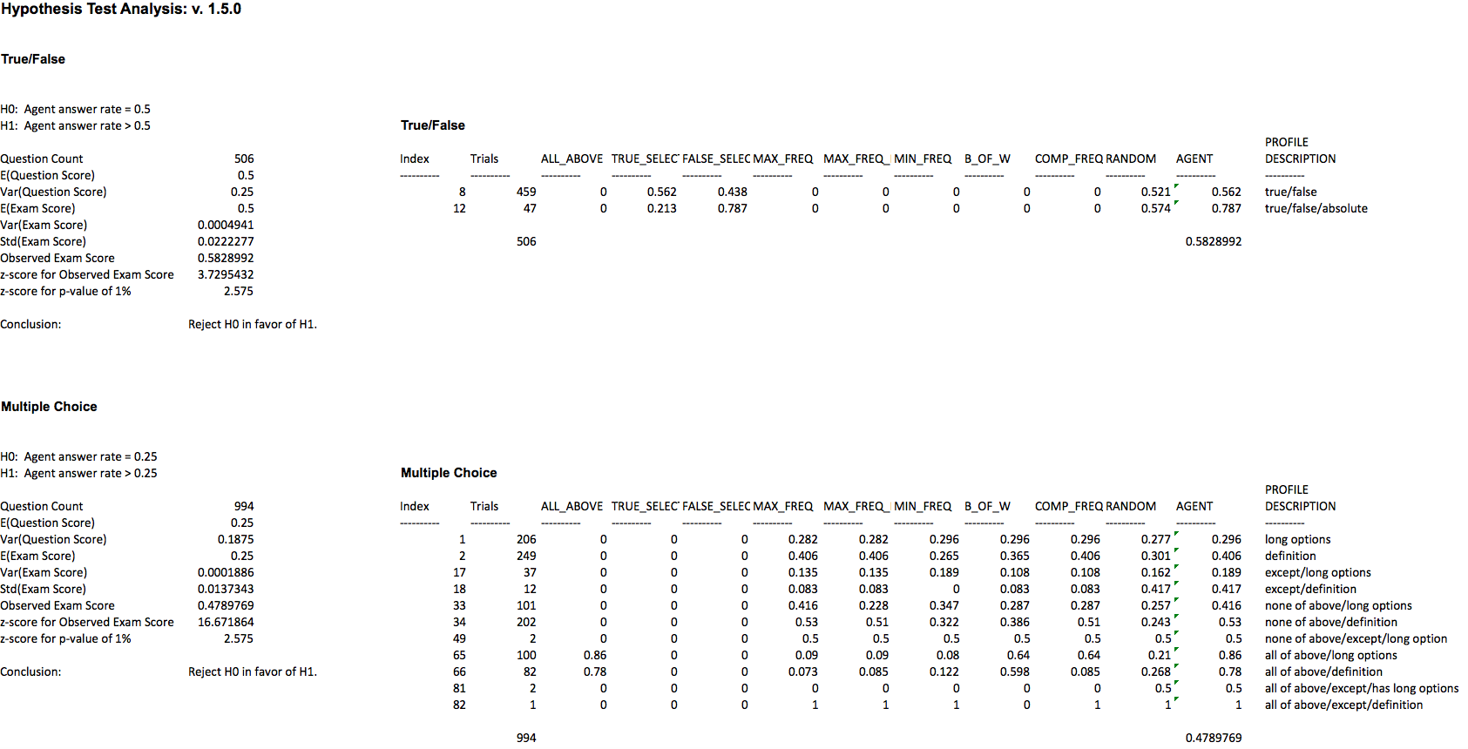
Performance Analysis – v. 1.5.0

Slide 30
Performance Analysis – v. 1.9.0
  1297 training set/203 test set
    Create profile based on 1297 training set
    score on test set: 100 out of 203 (49%)

Slide 31
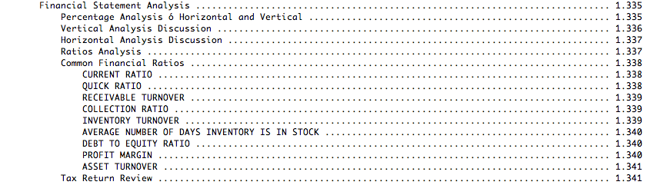
Future Work
Hierarchical structure of text

Slide 32
Future Work
Apply Information Retrieval (IR) Techniques
  Divide up manual into set of hierarchical documents, based on hierarchical structure of the manual, itself.
  These docs are of much finer granularity then the manual sections currently being used.
  Consider:
    Term frequency
    Document frequency
    Feature information – path within hierarchy, (parents, children)

Slide 33
Future Work
KB: Apply NLP/NLU techniques to the CFE Exam Questions in the training set
  Leverage semi-structure of the question.
  Question sparseness problem

Slide 34
Future Work
KB: Apply NLP/NLU techniques to other questions on the exam for which the accuracy rates using shallow techniques are high
  All of the above questions
  Absolute true/false questions

Slide 35
Related Work
Watson (Ferrucci, 2010)
Prismatic (Fan, 2008)
Halo Project (Friedland, 2004)

